Slide 1
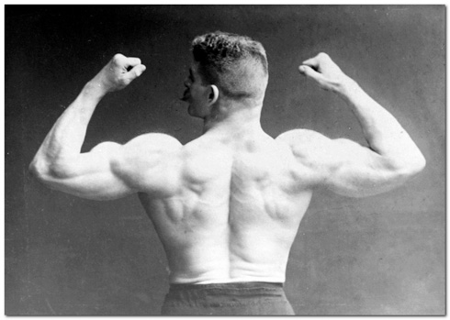
Major-element based exercises

Slide 2


8.5: Generalized mixing (mjr)
Exercise
Table contains compositions of three ideal rock-forming minerals making up a model olivine gabbro:
wt. % | SiO₂ | Al₂O₃ | FeOt | MgO | CaO | Na₂O
Pl | 50.54 | 31.70 | 0.00 | 0.00 | 14.36 | 3.40
Ol | 39.19 | 0.00 | 18.75 | 42.06 | 0.00 | 0.00
Di | 55.49 | 0.00 | 0.00 | 18.61 | 25.90 | 0.00
gabbro_modal.data
Calculate whole-rock geochemical composition of gabbro that contains
50 % Pl, 30 % Ol and 20 % Di.

Slide 3
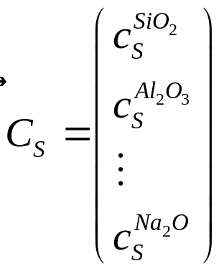
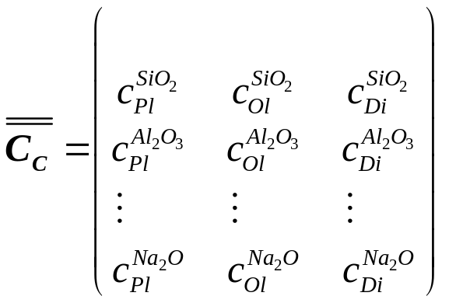
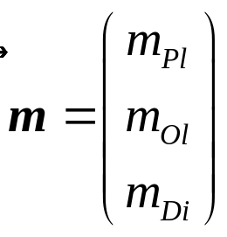
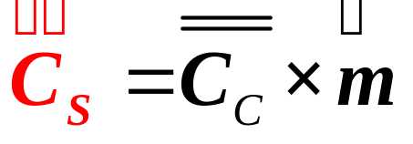
8.5: Generalized mixing (mjr)
This is a simple calculation leading to a matrix multiplication of a vector with mineral proportions by a matrix of mineral compositions read from the datafile.
~ Eq. [6.14]
For matrix multiplication in R, use the %*% operator.

Slide 4
8.2: Fractional crystallization (direct mjr)
Exercise
Table contains analyses of Sázava tonalite (Janoušek et al. 2004) and some of its rock-forming minerals (Janoušek et al. 2000):
wt. % | Tonalite | Pl | Bt | Amp
SiO₂ | 55.09 | 53.41 | 35.32 | 45.35
TiO₂ | 0.75 | 0 | 2.11 | 1.39
Al₂O₃ | 17.59 | 29.48 | 15.31 | 9.47
FeOt | 7.73 | 0.09 | 23.56 | 18.57
MgO | 3.52 | 0 | 9.05 | 9.82
CaO | 8.2 | 11.27 | 0.01 | 11.92
Na₂O | 2.83 | 5.05 | 0.1 | 1.08
K₂O | 2.04 | 0.12 | 9.81 | 1.02
sazava_fc.data
Calculate the composition of residual melt after 20% fractional crystallization of a cumulate consisting of 50 % Pl, 30 % Bt and 20 % Amp.
What is the composition of the cumulate?

Slide 5
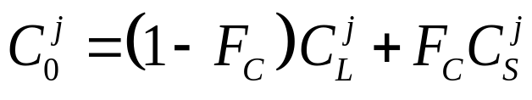

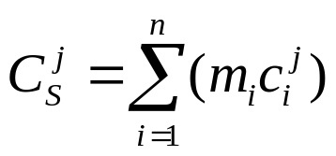
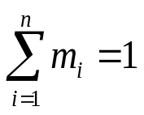
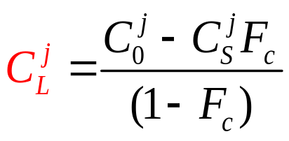
8.2: Fractional crystallization (direct mjr)
From mass-balance equation [6.6] for each element j:
Where:
Eq. [6.8]
Eq. [8.2]

Slide 6
9.4: “Normative” calculations
(reversed Ex. 8.5)
Exercise
wt. % | gabbro | Pl | Ol | Di
SiO₂ | 48.125 | 50.54 | 39.19 | 55.49
Al₂O₃ | 15.85 | 31.7 | 0 | 0
FeO | 5.625 | 0 | 18.75 | 0
MgO | 16.34 | 0 | 42.06 | 18.61
CaO | 12.36 | 14.36 | 0 | 25.9
Na₂O | 1.7 | 3.4 | 0 | 0
gabbro_modal2.data
Given the analyses of a gabbro and its mineral constituents (Table), estimate the wt. % of individual minerals using the least-square method.

Slide 7
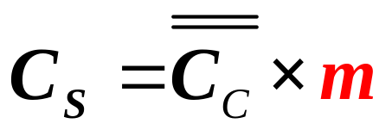

9.4: “Normative” calculations
(reversed Ex. 8.5)
Defining:
Allows a matrix formulation of:
~ Eq. [6.14]
And solve for e.g., by least-squares.

Slide 8
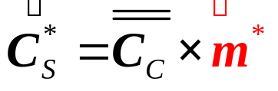
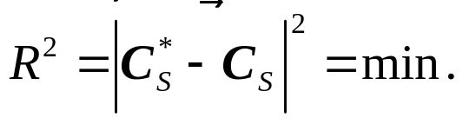
9.4: “Normative” calculations
(reversed Ex. 8.5)
The least-square method in R is implemented by the function lsfit setting intercept = FALSE, so that the model passes through the origin.
Such ‚normative‘ calculations by standard (unconstrained) least-squares and more sophisticated constrained least-square algorithms are obtained in GCDkit from menu Calculations|Norms…|Mode.
Unconstrained “modal” contents of minerals, both raw and recast to 100 %, are calculated by the function Mode; constrained solution is available via the function ModeC. Further details can be found on the relevant help page, see ?Mode.

Slide 9
9.1: Fractional crystallization (mjr)
(reversed Ex. 8.2)
Exercise
wt. % | tonalite | dif. magma | Pl | Bt | Amp
SiO₂ | 55.09 | 57.270 | 53.41 | 35.32 | 45.35
TiO₂ | 0.75 | 0.710 | 0 | 2.11 | 1.39
Al₂O₃ | 17.59 | 16.681 | 29.48 | 15.31 | 9.47
FeOt | 7.73 | 6.956 | 0.09 | 23.56 | 18.57
MgO | 3.52 | 3.230 | 0 | 9.05 | 9.82
CaO | 8.2 | 8.245 | 11.27 | 0.01 | 11.92
Na₂O | 2.83 | 2.845 | 5.05 | 0.1 | 1.08
K₂O | 2.04 | 1.748 | 0.12 | 9.81 | 1.02
sazava_fc2.data
Given the compositions of the parental magma (tonalite), differentiated melt and crystallizing minerals (Table), estimate (by the least-square method) the degree of fractional crystallization and mineral proportions in the cumulate.

Slide 10
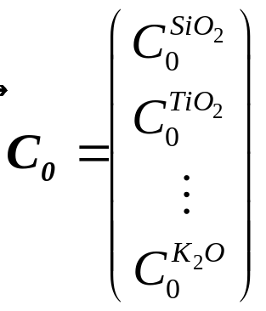
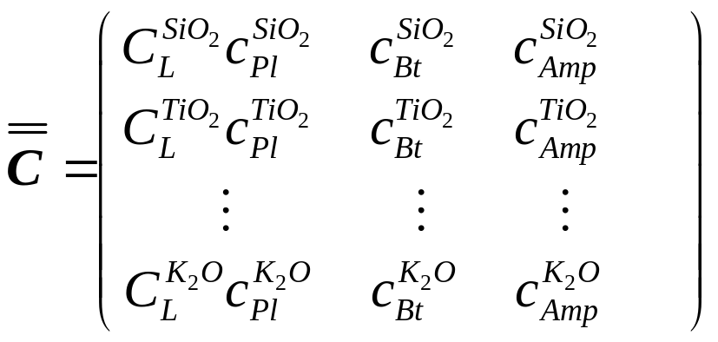
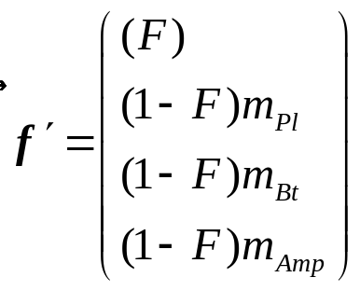
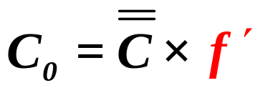

9.1: Fractional crystallization (mjr)
(reversed Ex. 8.2)
Setting:
Allows a matrix formulation:
Eq. [6.27]
And solve for e.g., by least-squares.

